Slide 1
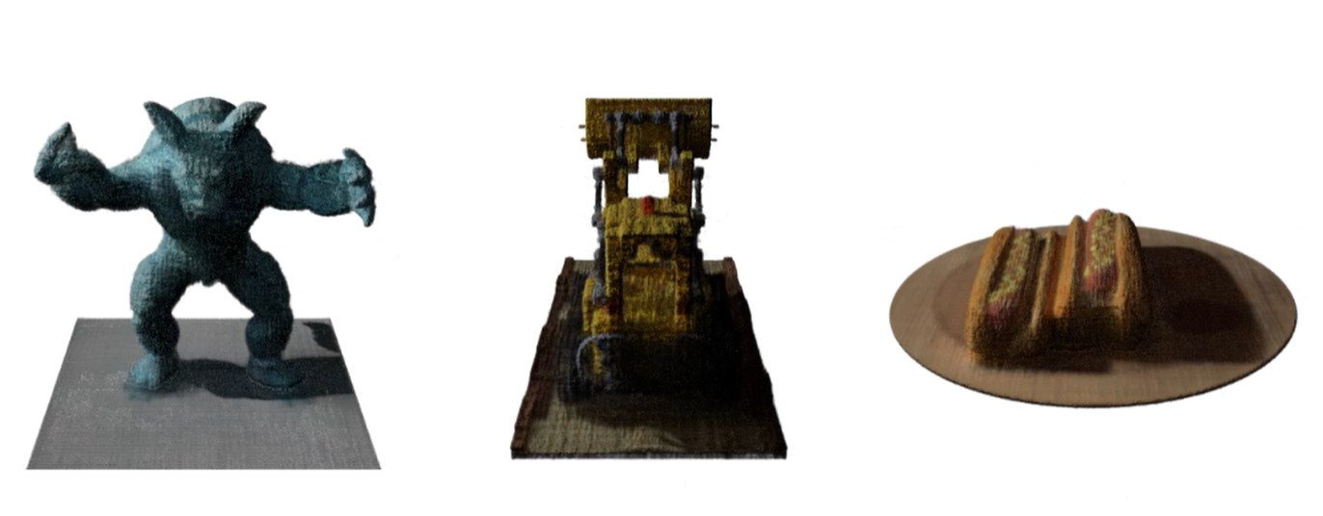
Machine Learning in Computer Vision (3D Reconstruction of Data from 2D Images)
Name: Abdul Basit
M1-Int track in Electrical Engineering
Submitted to:
Professor Lydie Nouveliere

Slide 2
Role of Machine Learning in 3D Reconstruction
Introduction to 3-D reconstruction.
Machine learning has evolved 3D reconstruction by automating feature detection and improving accuracy.
Traditionally, identifying image features like corners, shapes, and textures was time-consuming, but deep neural networks can now automatically recognize and match features, even in complex scenes. Additionally, machine learning models can:
Handle noise in the data, filling gaps for more accurate reconstructions.
Generalize to new scenes without manual intervention.
Efficiently reconstruct 3D models by learning scene priors from large datasets.

Slide 3
Scope of this paper
This paper focuses on 3D reconstruction from 2D images (passive methods). This approach is preferred due to its affordability and ease of data acquisition compared to LiDAR or depth sensors. However, challenges include:
Computational intensity, especially for high-resolution images.
Dependence on the number, quality, and lighting conditions of input images.

Slide 4
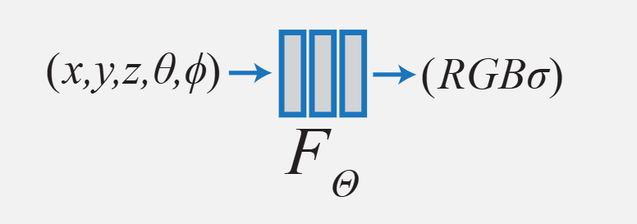
2. Neural Radiance Fields (NeRF)
Neural Radiance Fields (NeRF) is a neural rendering approach developed by researchers from Google and the University of California, Berkeley. NeRF maps spatial positions (x, y, z) and viewing direction (θ, Φ) into color (r, g, b) and density (σ) values, effectively modeling how light interacts with a 3D scene.

Slide 5
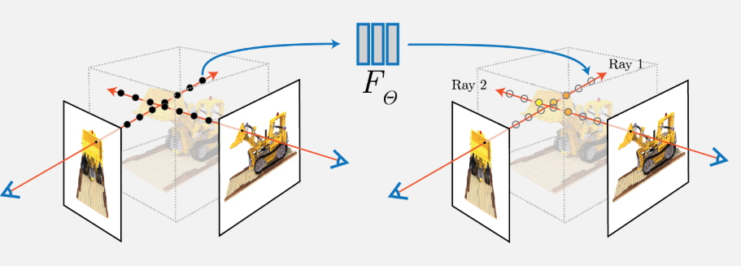
2.2 Architecture
NeRF uses a multi-layer perceptron (MLP) architecture with:
A 5D input (spatial location + viewing direction).
9 fully connected layers, each with 256 neurons.
Volume rendering to generate images from the learned 3D representation.
Two-pass rendering, where initial low-density samples refine future sample placements.

Slide 6
2.3 Toy Problem
One challenge is that NeRF struggles to memorize images effectively. To solve this, a positional encoding technique using sinusoidal functions expands feature vectors into higher dimensions, improving the model's ability to reconstruct images accurately.
NeRF can produce realistic 3D renderings with high detail but is data-intensive and requires a large number of images to generalize well.

Slide 7
3. Instant Neural Graphics Primitives with Multi-Resolution Hash Encoding
Neural graphics primitives rely on fully connected neural networks but are computationally expensive. NVIDIA introduced Instant NeRF, which speeds up training by using a multi-resolution hash table and a small neural network, optimizing through stochastic gradient descent.
Grid-based encoding replaces sinusoidal positional encoding.
16 resolution levels encode features in a hash table.
A small fully connected neural network predicts density and RGB values.

Slide 8
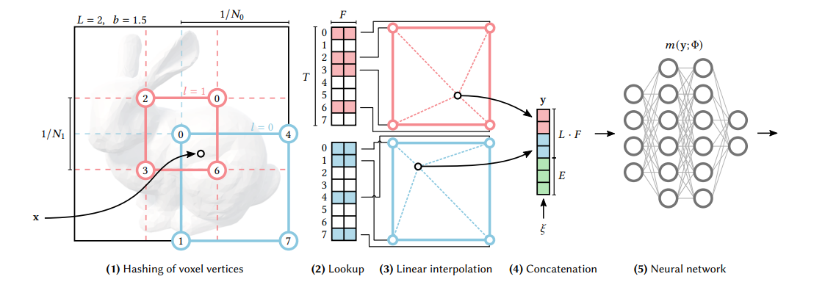
3.2 Architecture
CUDA optimization allows fast training and rendering.
Instant NeRF dramatically reduces training time, allowing real-time rendering and making it suitable for interactive 3D applications.

Slide 9
4. PixelNeRF: Neural Radiance Fields from One or Few Images
PixelNeRF improves upon NeRF by enabling single-image 3D reconstruction. Unlike standard NeRF, which requires multiple images per scene, PixelNeRF learns a scene-independent prior from a large dataset.
Uses a CNN encoder (ResNet34) to extract pixel-aligned features.
Features are mapped to NeRF's 3D volume rendering process.

Slide 10
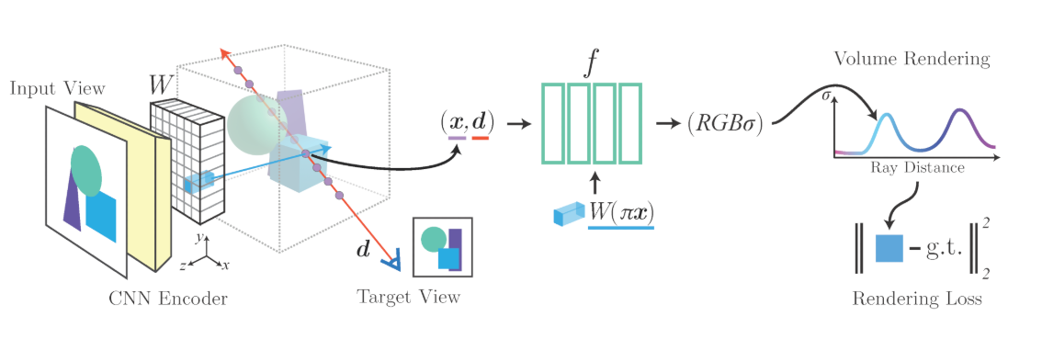
4.2 Architecture
Loss functions optimize the model using pixel-wise differences.
PixelNeRF enables high-quality reconstructions from just one or a few images, making it more data-efficient and generalizable.

Slide 11
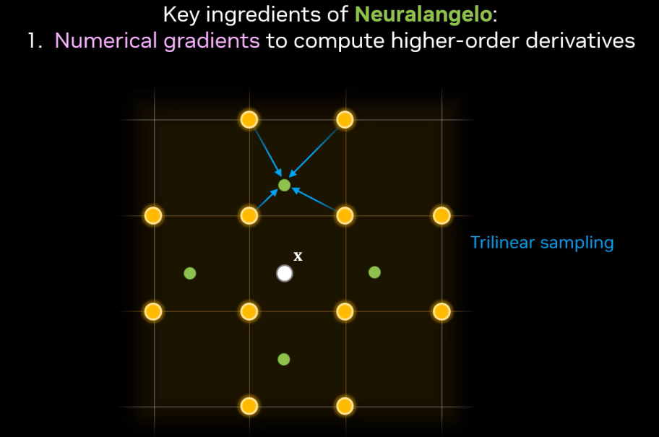
5. Neuralangelo: High-Fidelity Neural Surface Reconstruction
Neuralangelo improves upon NeRF by using multi-resolution hash grids and numerical gradients for fine surface details. It achieves high-fidelity reconstructions from multi-view images.
Scene Initialization & Signed Distance Function (SDF)
The scene is initialized as a rough sphere.
SDF computes the distance of a point from a surface boundary.
A loss function regularizes surface normals and curvature.

Slide 12
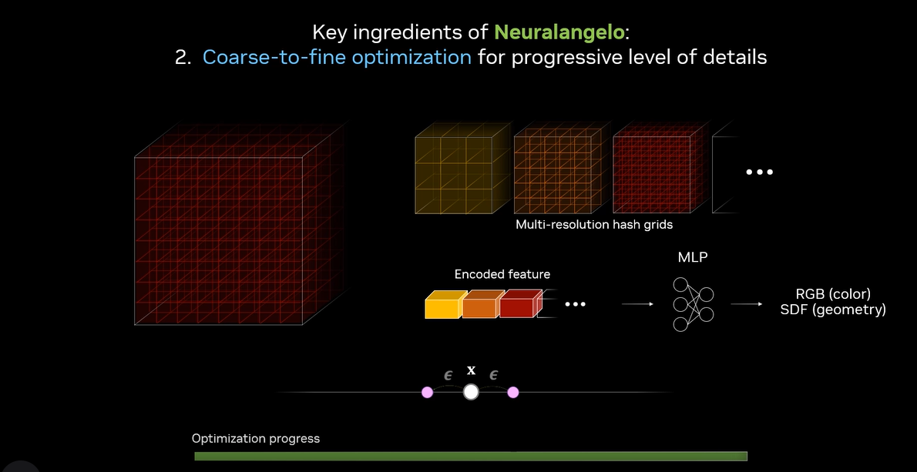
Architecture
Multi-Resolution Hash Grids & Numerical Gradients
Hash grids store feature vectors at different resolutions.
Numerical gradients improve surface detail preservation.
Progressive grid activation refines finer details over time.

Slide 13
6. Summary
Machine learning has significantly enhanced 3D reconstruction from images. While NeRF provides high-quality renderings, Instant NeRF enables real-time processing, PixelNeRF generalizes across scenes, and Neuralangelo refines fine details. These advancements make neural rendering a powerful tool for computer vision and graphics applications.

